Slide 1
Alexa Overview
Discussion and Demonstration
Jim Tannenbaum
December 18, 2020

Slide 2
Agenda
Overview of Voice and Chatbot Project
Alexa Demonstration
2021 – Next Steps
Q & A

Slide 3
What are the benefits of voice?
32.2 million (age 65+) adult Americans (~13%) reported having trouble seeing, even when wearing corrective lenses
2018 NHIS data
49.6% of adults 65+ report doctor diagnosed arthritis
2018 CDC data
Nearly 90 Million U.S. adults own a smart speaker
Apr 2020, Voicebot.ai
Parity with competitors
BCBS/Anthem, Cigna, & multiple independents

Slide 4
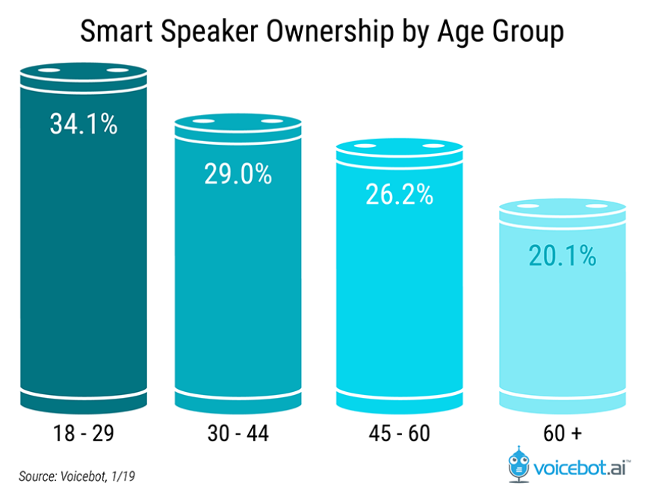
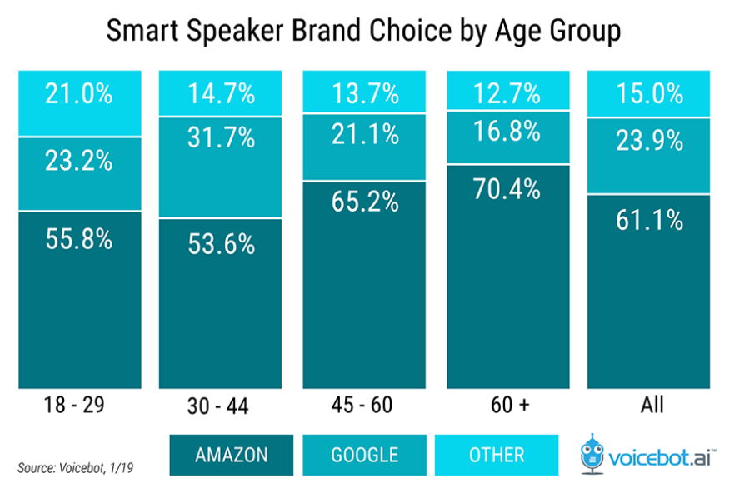
Voice Technology
The Medicare audience, or over 60-year-olds, are daily smart speaker users at 46.6% compared to just 43% for those under 30.
Voice technology comes in many shapes and sizes allowing consumers to determine what is the right fit for them.
U.S. smart speaker owners rose 40% in 2018 to reach 66.4 million with total smart speakers in use rising to 133 million.
Amazon Echo maintains a 61% market share among smart speaker owners while Google Home closed the gap by rising 5.5% to a 24% share
Third-party voice apps have a discovery problem more than a usage problem. Whereas only about 49% of users say they have tried third-party voice apps, 35% have become monthly active users.
Voicebot estimates smart speaker owners that try third-party voice apps check out an average of 2.7 different Alexa skills or Google Actions. This still appears to yield an impressive 26% trial to monthly use conversion rate.

Slide 5
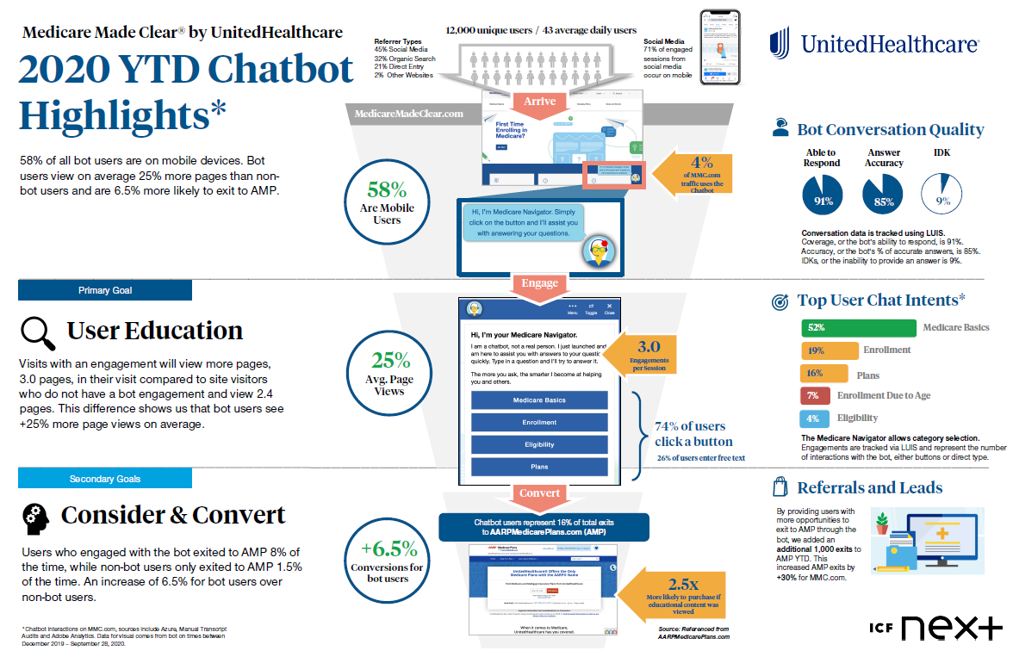

Slide 6
Convert Chatbot Data into a voice application
Received a list of the top 30 questions and answers
Broke down into four major topics:
Explain an insurance term
Compare two insurance terms
Eligibility for insurance
Insurance Cost
Users inquire about insurance terms using different terminology
For example, they may refer to Part A by any number of terms:
What is hospital insurance/coverage?
Does Medicare cover in patient hospital care?
Can voice handle different sentence structures and terms?
Yes!

Slide 7
Alexa demonstration

Slide 8
2021 – Next Steps
Engage a Development Team
Determine which team to utilize
Basking Ridge ATC Voice Pillar Team
Experience building on multiple platforms
~$145K - $220K + $37.5K Infrastructure / year, duration of ~4 months.
Innovation Team (working with ICF Next)
Experience building the Chatbot
~$95K, duration of 3 months
Utilize Contract Resources
Experience with both Chatbots and Voice
Biggest Challenge:
Create Awareness
Determine Criteria for success:
Focus Group for usefulness
Adoption of Skill
Knowledge Transfer
Close the Sale

Slide 9
Q & A

Slide 10
Thank you!

